Slide 1


Slide 2

Regulatory Roundtable: Updates and Outlook
17 December 2025

Slide 3
Agenda
Welcome & Introduction
Dr. Christian Thun, European DataWarehouse
Latest Developments in EU and UK Securitisation Regulation
Dr. Christian Thun, EDW Shaun Baddeley, AFME
Key Legal Insights
Marco Angheben, EDW Dr. Oliver Kronat, Clifford Chance
Conclusion & Next Steps
Dr. Christian Thun, European DataWarehouse

Slide 4
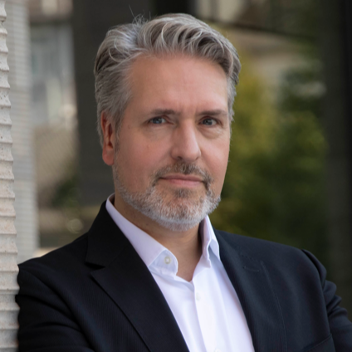
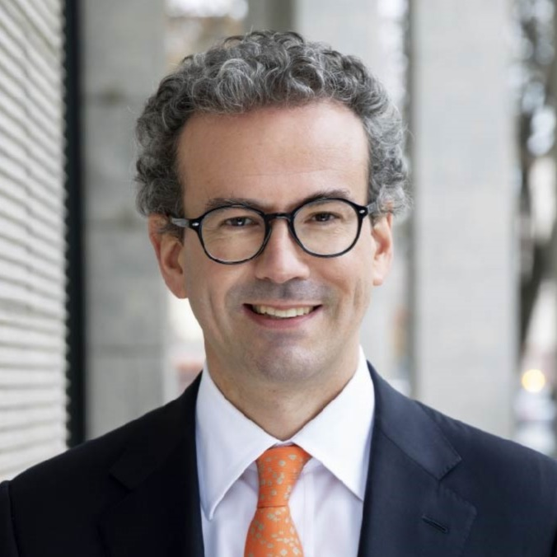
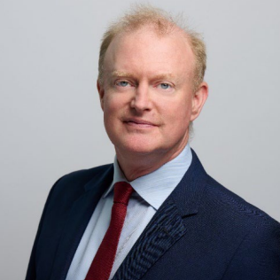
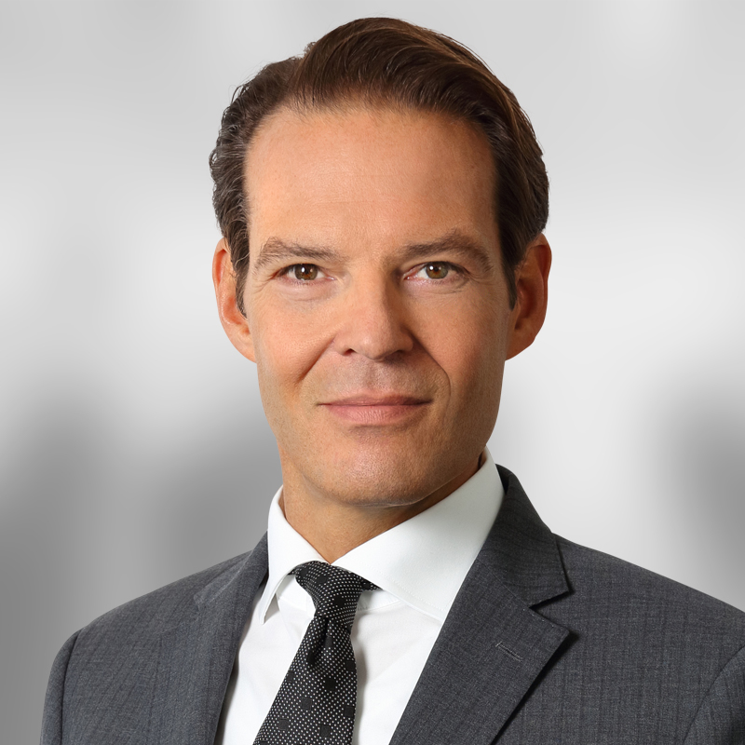
On today’s call – small group
Dr. Christian thun
Marco Angheben
European datawarehouse
christian,thun@eurodw.eu
marco.angheben@eurodw.eu
Shaun Baddeley
Oliver kronat
AFME
Clifford chance
shaun.baddeley@afme.eu
oliver.kronat@cliffordchance.com

Slide 5
Latest Developments in EU and UK Sec. Regulation
Dr. Christian Thun, EDW
Shaun Baddeley, AFME

Slide 6
Tentative Timeline for new securitisation framework
Assumed adaption from 2027
EU Commission publishes legislative proposal
New Securitisation Framework applies
Publication in OJ
EU Council formulates opinion
Trilogue discussions
EU Parliament formulates opinion
ESAs work on templates
2025
2026
2027
2028
17 June
13 Oct: EP public
hearing in ECON
15 Jan: EP draft
report in ECON
15 Dec: Publication of
EP draft report
5 May: EP Vote in
ECON committee

Slide 7
Key Legal Insights
Marco Angheben, EDW
Dr. Oliver Kronat, Clifford Chance

Slide 8
Conclusion & Next Steps
Dr. Christian Thun, EDW

Slide 9

Q&A

Slide 10

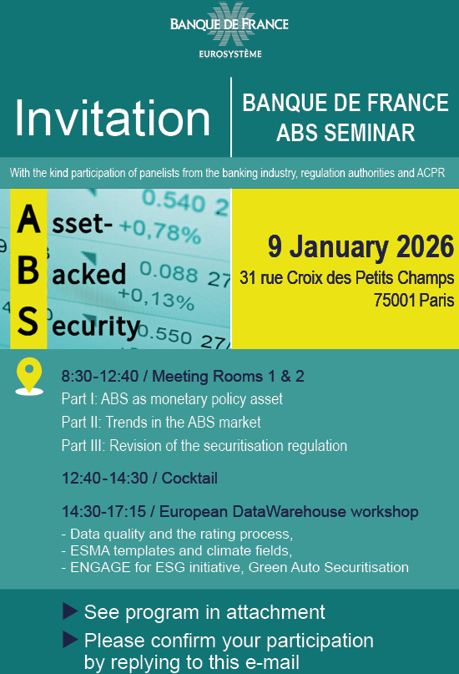
Upcoming events: H1 2026

Slide 11

Thank You
Contact Us

Slide 12

Thank You

